Slide 1
DBMS Relational Model and Relational Algebra

Slide 2
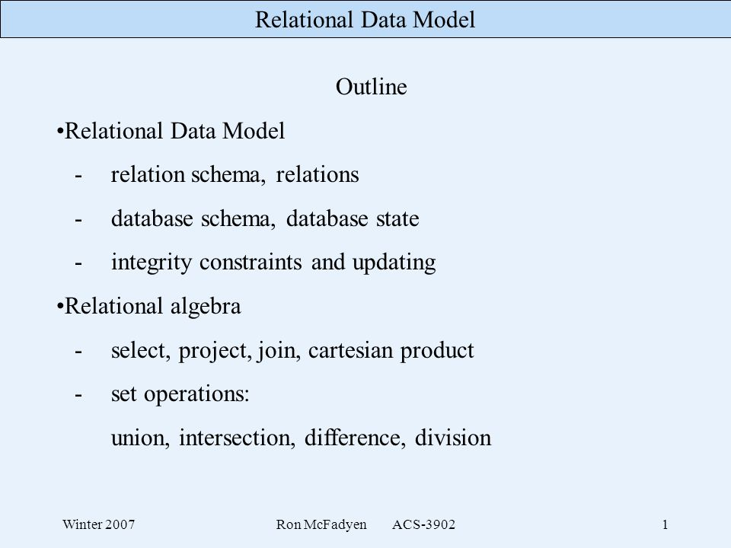

Slide 3
Relational Algebra
Relational algebra is a procedural query language, which takes instances of relations as input and yields instances of relations as output.
It uses operators to perform queries. An operator can be either unary or binary.
Relational algebra is performed recursively on a relation and intermediate results are also considered relations.
Relational algebra mainly provides theoretical foundation for relational databases and SQL.

Slide 4
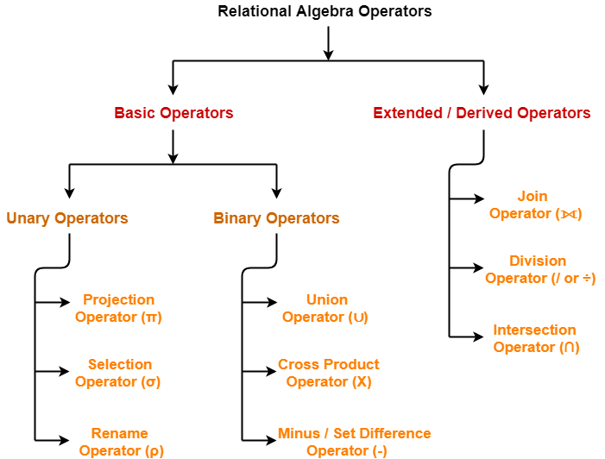

Slide 5
Projection (π)
Projection is used to project required column data from a relation.
extract the values of specified attributes to eliminates duplicate values. (pi) symbol is used to choose attributes from a relation.
This operator helps you to keep specific columns from a relation and discards the other columns.

Slide 6
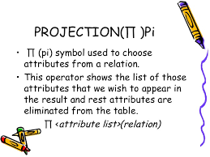

Slide 7
R
(A B C)
----------
1 2 4
2 2 3
3 2 3
4 3 4
π (BC)
B C
-----
2 4
2 3
3 4

Slide 8
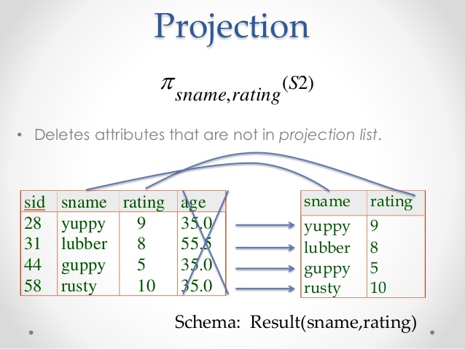

Slide 9
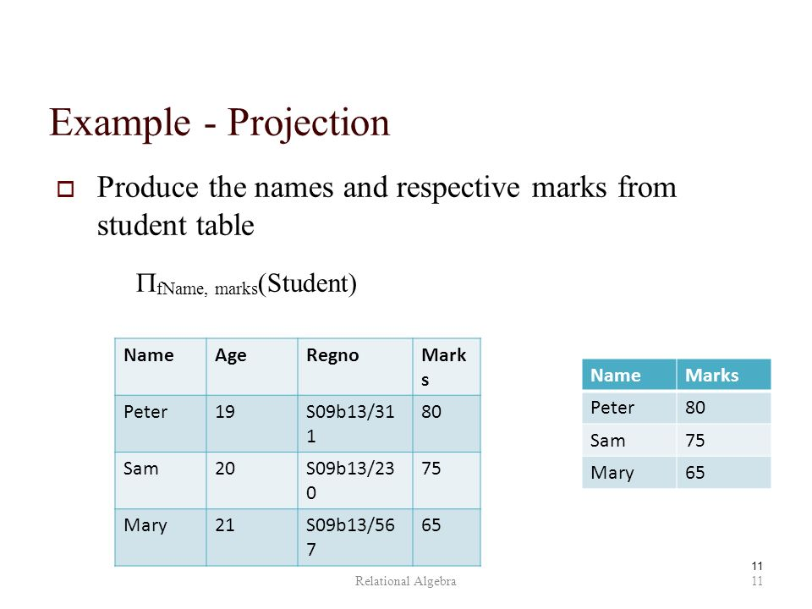

Slide 10
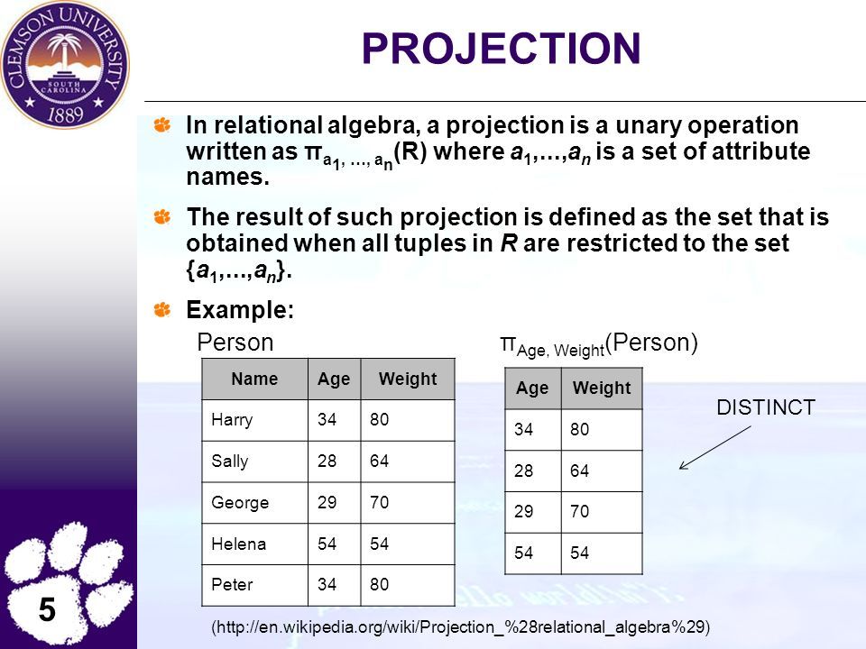

Slide 11
Selection (σ)
Selection is used to select required tuples of the relations.

Slide 12
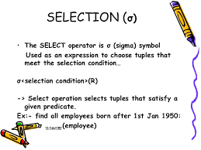

Slide 13
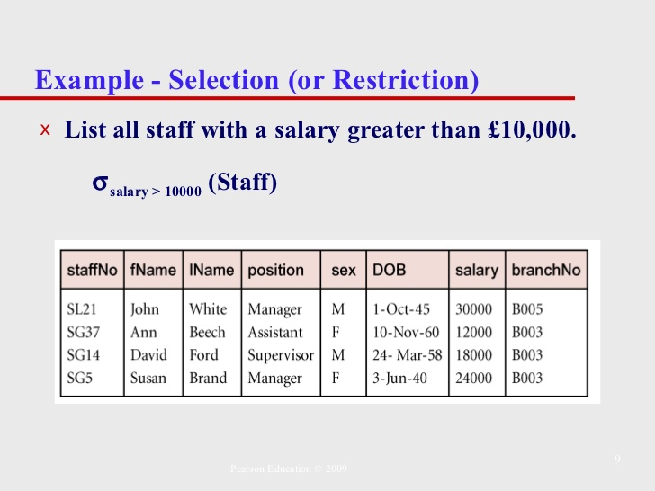

Slide 14
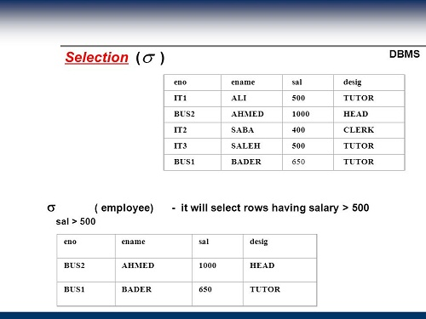

Slide 15
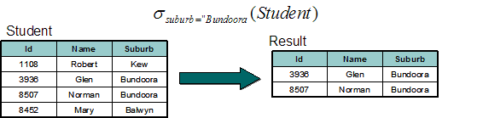

Slide 16
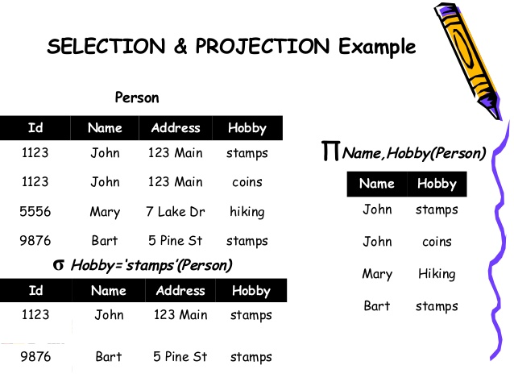

Slide 17
Rename (ρ) -> (Rho )
Rename is a unary operation used for renaming attributes (column) of a relation.

Slide 18
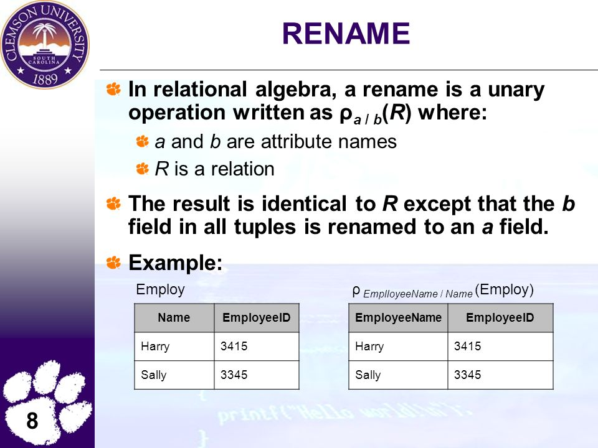

Slide 19
Union (U)
Union operation in relational algebra is same as union operation in set theory, only constraint is for union of two relation both relation must have same set of Attributes

Slide 20
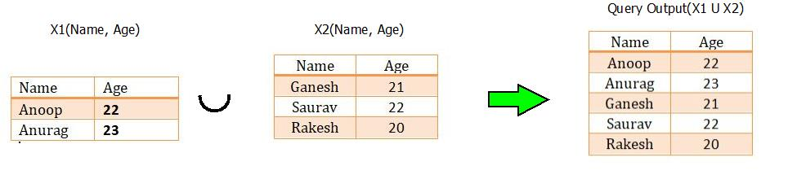

Slide 21
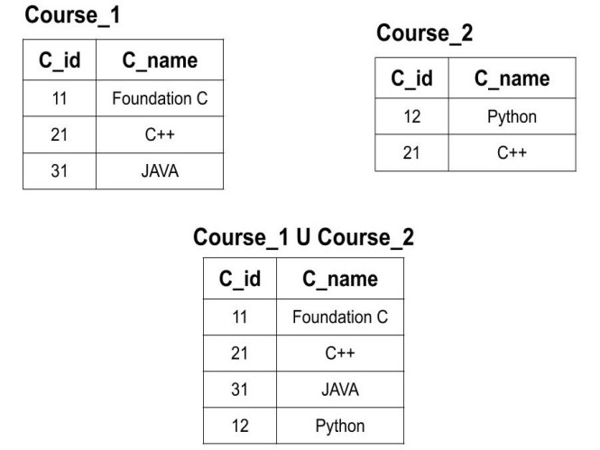

Slide 22
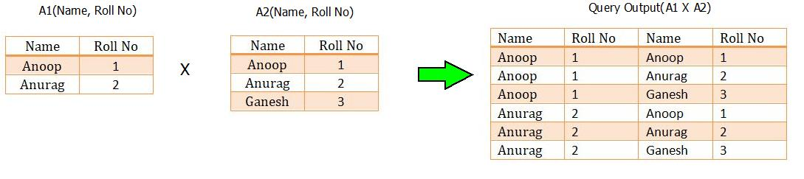
Product

Slide 23
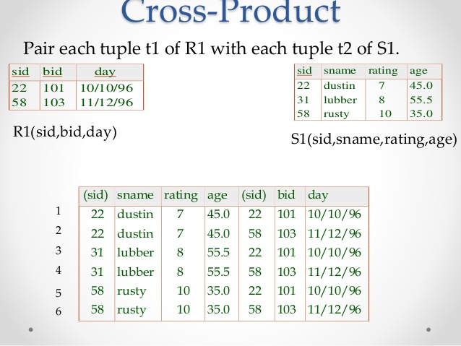

Slide 24
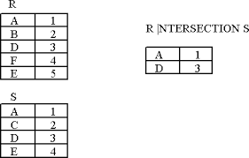
Intersection (Common)

Slide 25
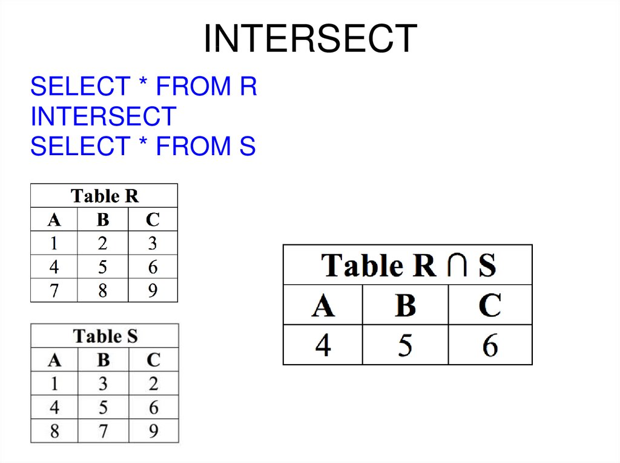

Slide 26
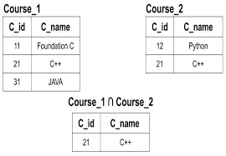

Slide 27
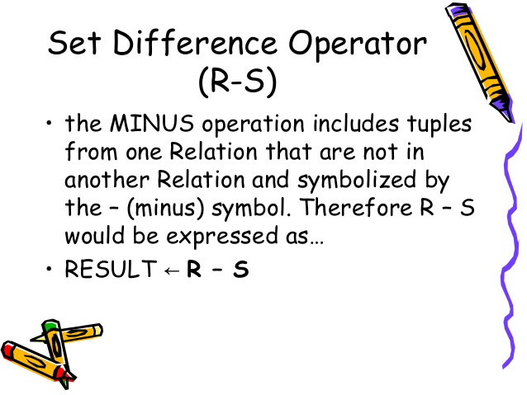

Slide 28
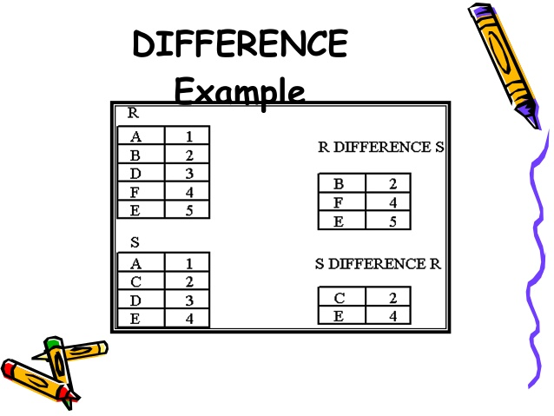

Slide 29
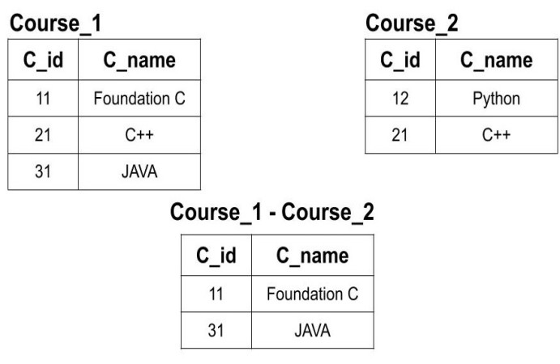

Slide 30
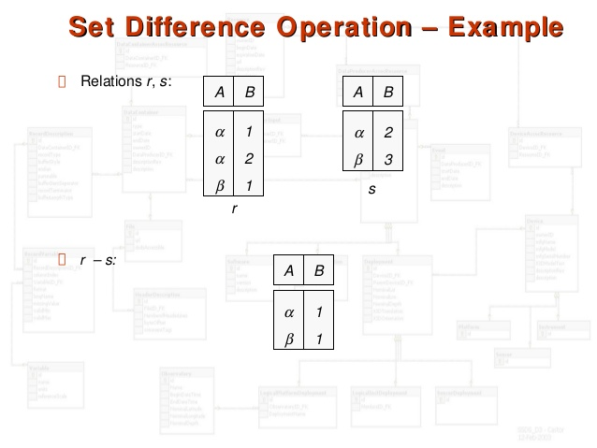

Slide 31
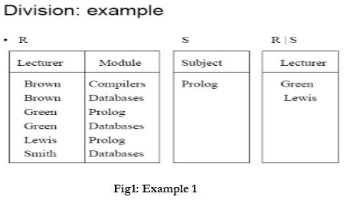

Slide 32
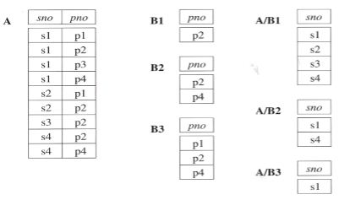

Slide 33
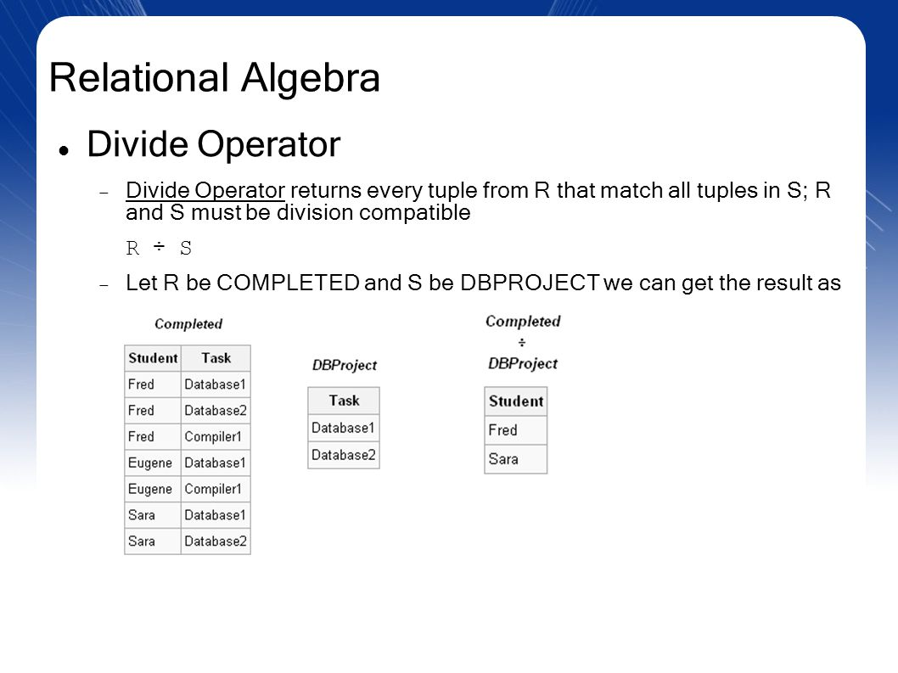

Slide 34
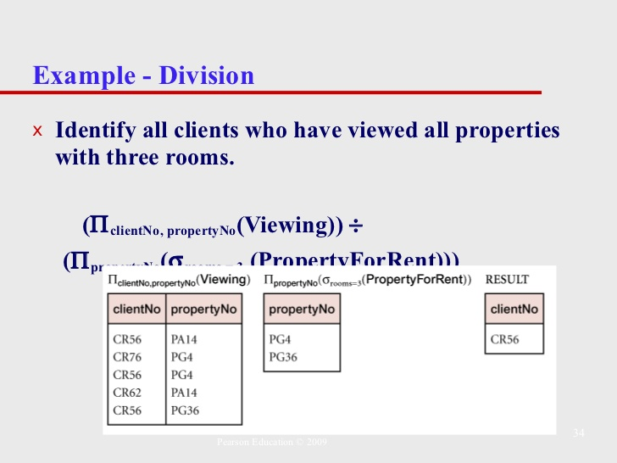

Slide 35
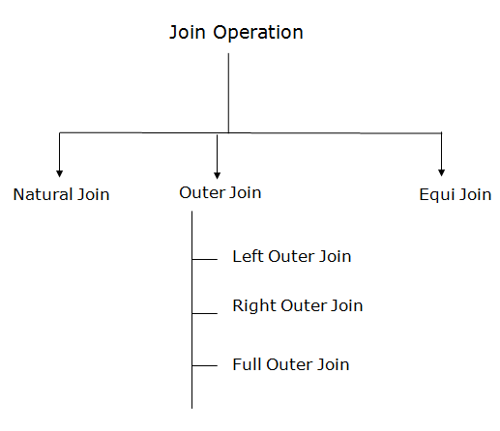

Slide 36
A Join operation combines related tuples from different relations, if and only if a given join condition is satisfied.
It is denoted by ⋈.
JOIN operation also allows joining variously related tuples from different relations.

Slide 37
Join
EMP_CODE | EMP_NAME
101 | Stephan
102 | Jack
103 | Harry
EMP_CODE | SALARY
101 | 50000
102 | 30000
103 | 25000
(EMPLOYEE ⋈ SALARY)
EMP_CODE | EMP_NAME | SALARY
101 | Stephan | 50000
102 | Jack | 30000
103 | Harry | 25000

Slide 38
Natural Join
Natural join can join tables based on the common columns in the tables being joined.
A natural join returns all rows by matching values in common columns having same name and data type of columns and that column should be present in both tables.
All non matching tuples are ignored.

Slide 39
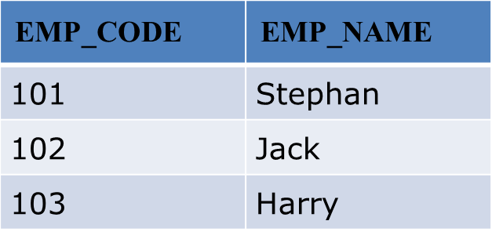
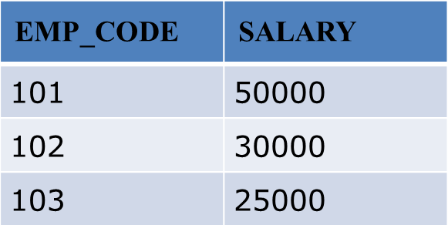
∏EMP_NAME, SALARY (EMPLOYEE ⋈ SALARY)
EMP_NAME | SALARY
Stephan | 50000
Jack | 30000
Harry | 25000

Slide 40
Eid | Ename | Did
1 | Rohan | 10
2 | Mohan | 30
3 | Sohan | 50
Did | Dname
10 | IT
30 | HR
40 | TIS
Employee ⋈ Department
Eid | Ename | Did | Did | Dname
1 | Rohan | 10 | 10 | IT
2 | Mohan | 30 | 30 | HR

Slide 41
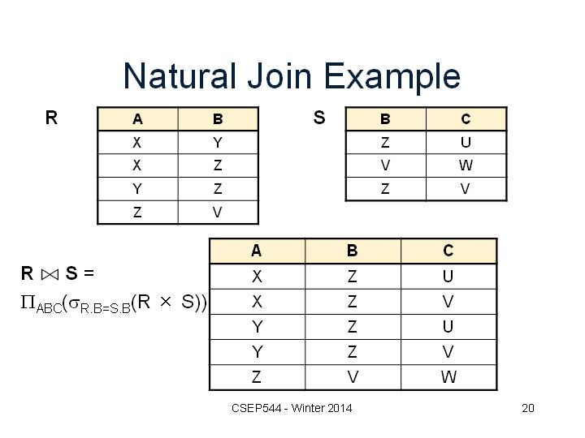

Slide 42
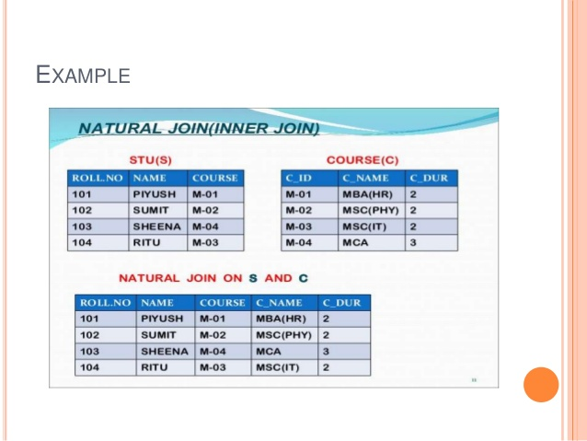

Slide 43
Equi join(Inner join)
It is also known as an inner join. It is the most common join.
It is based on matched data as per the equality condition.
The equi join uses the comparison operator(=).
All non-matching tuples are removed.

Slide 44
Equi Join
CLASS_ID | NAME
1 | John
2 | Harry
4 | Jackson
PRODUCT_ID | CITY
1 | Delhi
2 | Mumbai
3 | Noida
CUSTOMER ⋈customer.class_ID=Product.Product_ID PRODUCT
CLASS_ID | NAME | PRODUCT_ID | CITY
1 | John | 1 | Delhi
2 | Harry | 2 | Mumbai

Slide 45
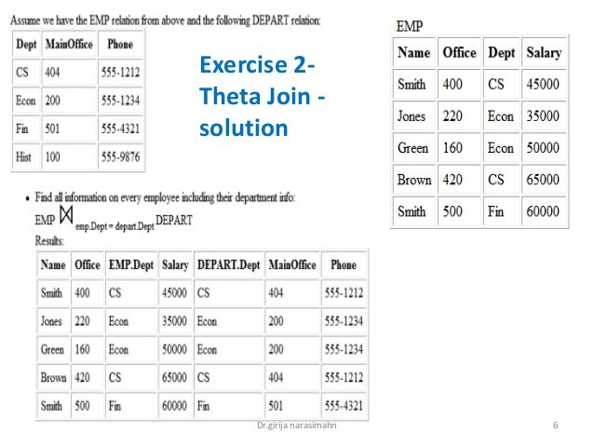

Slide 46
Outer Join
In Inner join rows that do not satisfy the join conditions are discarded.
Outer join joins two tables although there is no match between two joining tables.

Slide 47
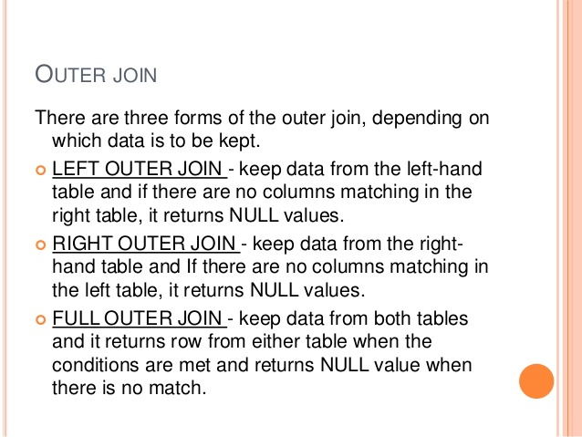

Slide 48
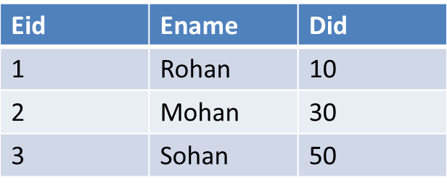
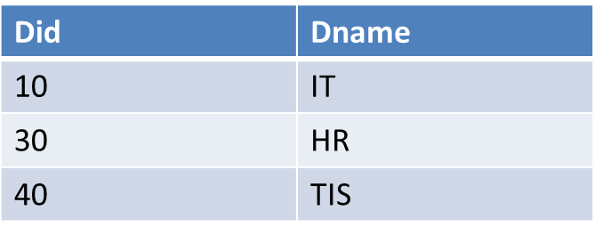
Left Outer Join
Eid | Ename | Did | Did | Dname
1 | Rohan | 10 | 10 | IT
2 | Mohan | 30 | 30 | HR
3 | Sohan | 50 | NULL | NULL

Slide 49
In the right outer join, operation allows keeping all tuple in the right relation.

Slide 50
Right Outer Join
Eid | Ename | Did | Did | Dname
1 | Rohan | 10 | 10 | IT
2 | Mohan | 30 | 30 | HR
NULL | NULL | NULL | 40 | TIS

Slide 51
In a full outer join, all tuples from both relations are included in the result irrespective of the matching condition.

Slide 52
Full Outer Join
Eid | Ename | Did | Did | Dname
1 | Rohan | 10 | 10 | IT
2 | Mohan | 30 | 30 | HR
3 | Sohan | 50 | NULL | NULL
NULL | NULL | NULL | 40 | TIS

Slide 53
The primary difference between an inner(Equi) and natural join is that inner joins have an explicit join condition,
whereas the natural join’s conditions are formed by matching all pairs of columns in the tables that have the same name and compatible data types, making natural joins equi-joins because join condition are equal between common columns. (If the data types are incompatible, Vertica returns an error.)

Slide 54
Inner Join
This is the most used join in the SQL. this join returns only those records/rows that match/exist in both the database tables.

Slide 55
Equi Join
Equi join is a special type of join in which we use only an equality operator.
Hence, when you make a query for join using equality operator then that join query comes under Equi join.
The equi join creates a JOIN for equality or matching of the single or multiple column values of the relative tables.
Apart from that, the equi join also create the JOIN by using JOIN along with the ON clause and then providing the names of the columns with their relative tables to check equality using the equal operator.

Slide 56
Natural Join
A natural join is a type of equi join which occurs implicitly by comparing all the same names columns in both tables.
The join result has only one column for each pair of equally named columns.
In other words, the Natural Join helps to join the two tables based on the same attribute name and the datatypes.
The result of the JOIN table will contain all the attributes of both tables but keep only one copy of each common column accordingly.

Slide 57
Thank you !

